Slide 1
MATLAB Fuzzy Logic Toolbox
CSE 470/573 Theory of Fuzzy System

Slide 2
MATLAB Fuzzy Logic Toolbox
Introduction
Graphical User Interface (GUI) Tools
Example: Dinner for two

Slide 3
Introduction
MATLAB fuzzy logic toolbox facilitates the development of fuzzy-logic systems using:
  graphical user interface (GUI) tools
  command line functionality

Slide 4
Introduction
Graphical User Interface (GUI) Tools
There are five primary GUI tools for building, editing, and observing fuzzy inference systems in the Fuzzy Logic Toolbox:
Fuzzy Inference System (FIS) Editor
Membership Function Editor
Rule Editor
Rule Viewer
Surface Viewer

Slide 5
MATLAB Fuzzy Logic Toolbox
Introduction
Graphical User Interface (GUI) Tools
Example: Dinner for two

Slide 6
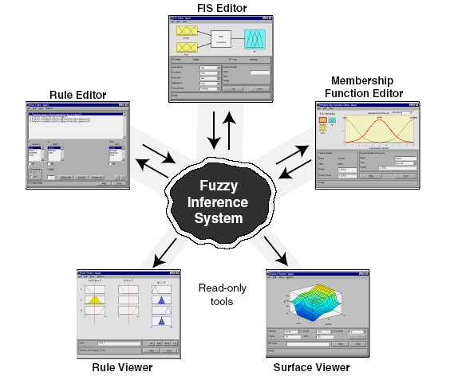
Graphical User Interface (GUI) Tools

Slide 7
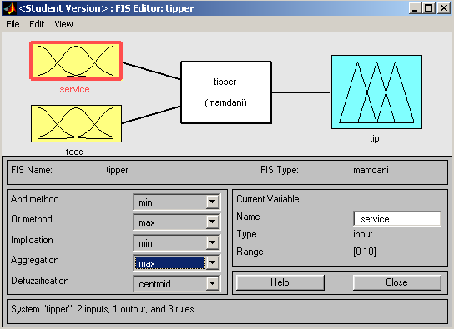
Graphical User Interface (GUI) Tools
Fuzzy Inference System (FIS) Editor
Define number of input and output variables
Adjust fuzzy inference functions
Name and edit names of input, output variables

Slide 8
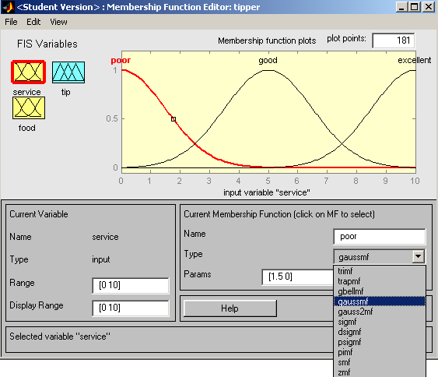
Graphical User Interface (GUI) Tools
Membership Function Editor
Select & edit attributes of membership function
Display & edit values of current variable
Name & edit parameters of membership function

Slide 9
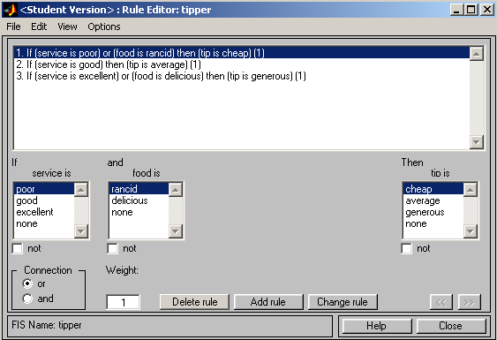
Graphical User Interface (GUI) Tools
Rule Editor
Rules – automatically updated
Create and edit rules

Slide 10
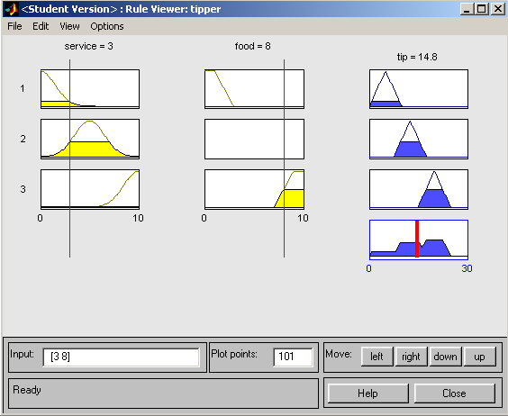
Graphical User Interface (GUI) Tools
Rule Viewer
Shows how input variable is used in rules
Shows how output variable is used in rules; shows output of fuzzy system

Slide 11
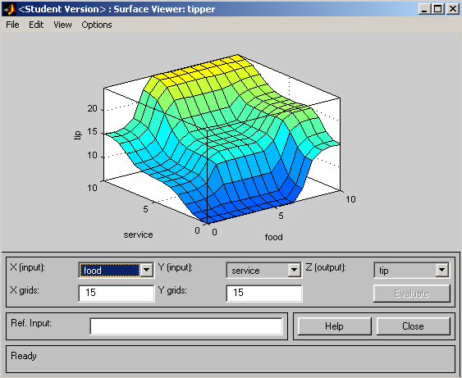
Graphical User Interface (GUI) Tools
Surface Viewer
Shows output surface for any system output versus any one (or two) inputs
Specify input and output variables

Slide 12
MATLAB Fuzzy Logic Toolbox
Introduction
Graphical User Interface (GUI) Tools
Example: Dinner for two

Slide 13
Example: Dinner for two
Golden rules for tipping:
IF the service is poor OR the food is rancid, THEN tip is cheap (5%).
2. IF the service is good, THEN tip is average (15%).
3. IF the service is excellent OR the food is delicious, THEN tip is generous (25%).

Slide 14
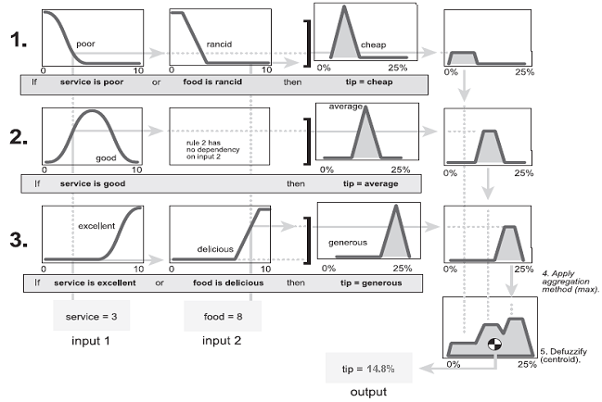
Example: Dinner for two

Slide 15
Example: Dinner for two
Fuzzy Inference System (FIS) Editor
input variables
output variable

Slide 16
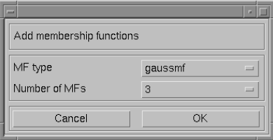
Example: Dinner for two
Membership Function Editor
Select type of membership function

Slide 17
Example: Dinner for two
Rule Editor
October 2005

Slide 18
Example: Dinner for two
Rule Viewer
Defuzzified output

Slide 19
Example: Dinner for two
Surface Viewer

